Slide 1


20
/20
20 AI Tools
in 20 Minutes
(And What You Get Free)
No laptops. No theory. Pick one tool tonight.
Tony Self, MBA
Broker/Owner, Harcourts Hunter Mason Realty
South Bay Association of REALTORS | October 28, 2026
Notes:
Quick show of hands. Who tried ChatGPT, got one beige, generic answer, and quietly went back to doing it the old way? Perfect. This is for you. Twenty tools, twenty minutes. No theory. No laptops. I am only going to really show you three. Your job is not to remember twenty names. Your job is to find one thing worth trying tonight.

Slide 2

0:40
AI moves faster than people admit
“I still have moments where I say,
Holy shit, it can do that now?”
“
Tried it once
Got a boring answer
Moved on
The room is not behind. The tools jumped again.
Real estate agents are salespeople. The shortcut has to work on the phone.
Notes:
I do not buy the idea that everybody already understands this technology. Most people have dabbled. Then the technology made another jump, and they missed it. Now some people are too embarrassed to admit they do not know what changed. Real estate agents are not supposed to be technology experts. They are salespeople. So I am going to show the shortcut, not give you homework.

Slide 3

0:40
Yes, ChatGPT built this deck
THE BRIEF
Research current tools
Build a complete, ready-to-deliver real estate agent class. Make it current. Twenty tools. Five buckets. Three live demos. Write it in my voice. Then build the actual PowerPoint.
Verify what is actually free
Write the spoken scripts
Create the PowerPoint
Add notes, timing and QR
One brief. One deck. Speaker notes included.
A project is optional. It just makes future updates easier.
Notes:
This presentation is also part of the demonstration. I gave ChatGPT the class brief, the audience, the date, the compliance requirements, the twenty-tool rule, the time limits, and my voice. It researched the tools, built the structure, generated the visuals, created the PowerPoint, and put the script in the speaker notes. I still reviewed it. That is the point. AI did the production work. I kept the judgment.

Slide 4
0:40
You already have more than you think
ChatGPT
Gemini
Claude
Apple
Gmail
Zoom
Zillow
Instagram
The biggest shift is not another app. It is what the apps you already have can do now.
Notes:
I am not counting these as twenty separate subscriptions. You already know the names. The useful question is what changed inside them. ChatGPT can search your connected email. Apple and Gmail can clean up writing. Zillow can work inside ChatGPT. Instagram has a serious mobile editor. The shift is not always another app. Sometimes it is a new capability inside the app you already use.

Slide 5
0:30
Five buckets. Pick one win.
Kill the
keyboard
Win the
appointment
Know the
property
Look sharp,
fast
Run the
business
20 tools
3 live demos
1 link page
Notes:
Everything goes into one of five buckets. Kill the keyboard. Win the appointment. Know the property. Look sharp. Run the sales business. I am showing you twenty, but I only expect you to remember the buckets, the three demos, and the QR code.

Slide 6
BUCKET 1
1:05
Kill the keyboard
01
Connected email
Find the thread, summarize, draft, stop.
Plan and permissions vary
Apple and Gmail proofread
Clean the message you already wrote.
Built in on eligible plans
Talk. Find. Fix.
Merge.
FluidVoice
Talk into almost any text field.
Free, local first
Four tools. One job.
PDFgear
Edit, merge, split and sign PDFs.
Free today
Notes:
Connected email means I can describe the conversation I am looking for, find it, summarize it, and prepare a reply. Apple Writing Tools and Gmail can proofread what you already wrote. FluidVoice lets you dictate into almost any text field, which is useful when you are moving. PDFgear handles the practical document work we all do, merging, splitting, reordering, signing, and editing ordinary working PDFs.
[Sources]
- https://help.openai.com/en/articles/11487775-connected-apps-in-chatgpt
- https://support.apple.com/guide/iphone/writing-tools-write-improve-summarize-iph6f08da1d2/ios
- https://support.google.com/mail/answer/16887555
- https://fluidvoice.com/
- https://www.pdfgear.com/
[/Sources]

Slide 7

LIVE DEMO 1
2:20
Demo: Find the email
Find the latest conversation with fictional client Jordan Vale about the Harbor View condo sale. Show me the source emails. Summarize the showing instructions and any unanswered questions. Draft a short reply in my voice. Do not send anything.
1
Search
2
Cite
It found it. It organized it. I still hit send.
3
Draft
4
Review
Fallback: prerecorded screen capture
Notes:
Use a demonstration inbox with fictional messages. Ask ChatGPT to find the latest conversation with Jordan Vale about the fictional Harbor View condo sale. Show the source emails. Let it summarize the instructions and unanswered questions. Then let it draft a reply. Do not let it send. My closing line is, it found it, it organized it, and I still hit send. If the connection is slow, play the prerecorded screen capture and keep moving.
[Sources]
- https://help.openai.com/en/articles/11487775-connected-apps-in-chatgpt
[/Sources]

Slide 8
BUCKET 2
1:05
Win the appointment
02
ChatGPT Voice
Rehearse the hard seller question.
Limited free access
Gemini Notebook
Turn source material into audio.
Free standard plan
Practice. Learn.
Present. Connect.
Claude PowerPoint
Turn notes into an editable deck.
Available on Free
Four tools. One job.
Blinq
Share contact, capture contact, follow up.
Free card and 2 cards
Notes:
ChatGPT Voice can practice the hard seller conversation before there is a commission attached. Gemini Notebook turns your own material into an audio overview and source-backed answers. Claude can take an outline and create an editable PowerPoint. Blinq gives you a phone-first digital business card so it is easier for a prospect to keep your information and share theirs.
[Sources]
- https://help.openai.com/en/articles/8400625-voice-mode-faq
- https://notebook.google/plans
- https://support.claude.com/en/articles/12111783-create-and-edit-files-with-claude
- https://blinq.me/
[/Sources]

Slide 9

LIVE DEMO 2
1:50
Demo: Practice the objection
You are a homeowner interviewing me to sell your home. Another agent offered a lower fee. Ask me why I am worth hiring. Ask one challenging follow-up. Then tell me one specific thing to improve.
Practice before commission is attached.
Notes:
Open ChatGPT Voice on the phone. Use the exact prompt on the slide. Answer naturally. Let the room hear one follow-up question and one piece of feedback. The lesson is not prompt engineering. The lesson is practice. You can rehearse pricing, commission, repairs, a listing that did not sell, or a seller who thinks Zillow already did the work.
[Sources]
- https://help.openai.com/en/articles/8400625-voice-mode-faq
[/Sources]

Slide 10

LIVE DEMO 3
2:15
Demo: Learn by listening
Use your material, not a random podcast.
Seller guide in.
Audio overview out.
Source-backed answers too.
Play 20 seconds. Then ask one live question.
180 questions. 2.5 hours. Two days listening.
Passed with a very high score.
Notes:
This is personal. I had a CACM exam with about 180 questions over two and a half hours. I learn well by listening. I loaded the material into Gemini Notebook, generated an audio overview, and listened for two days. I passed with a very high score. For the demo, play about twenty seconds of an already generated audio overview from a fictional seller guide. Then ask one live question and show that the answer points back to the source.
[Sources]
- https://notebook.google/plans
- https://support.google.com/gemininotebook/answer/16213268
[/Sources]

Slide 11
BUCKET 3
1:00
Know the property
03
Zillow inside ChatGPT
See the number sellers may see.
Free for eligible users
Google Lens
Identify labels and copy text fast.
Free mobile feature
Search. See. Map.
Verify.
Atlas
Map your actual sales history.
3 projects, 5,000 geocodes
Four tools. One job.
ChatGPT Search
Research public facts with sources.
Available on Free
Notes:
Zillow inside ChatGPT helps you see the number and property information a seller may already be looking at. It starts the conversation. It does not price the listing. Google Lens can identify an appliance label or copy text from a photo. Atlas can turn permitted MLS sales data into a map of your actual experience. ChatGPT Search can research a public property question and show the sources.
[Sources]
- https://www.zillow.com/news/zillow-becomes-first-real-estate-app-in-chatgpt/
- https://lens.google/
- https://atlas.co/pricing/
- https://help.openai.com/en/articles/9237897-chatgpt-search
[/Sources]

Slide 12
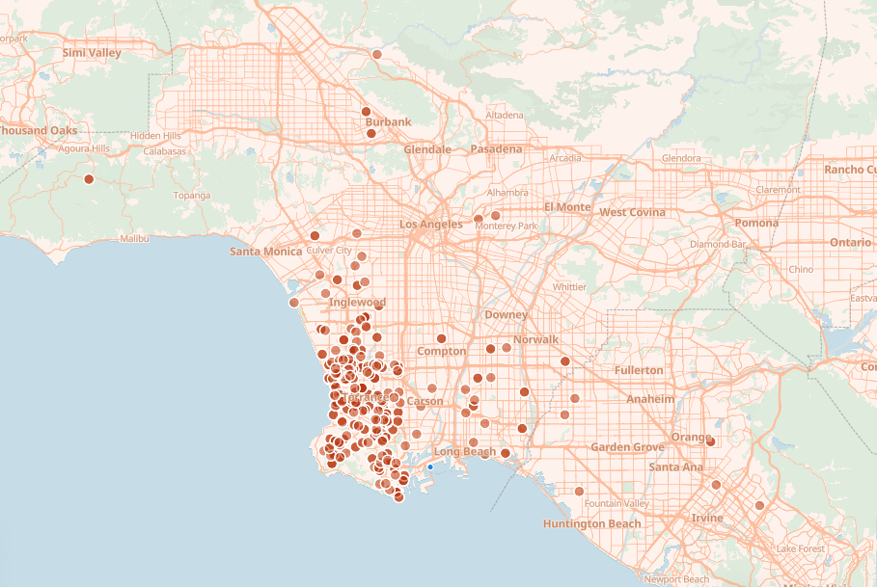
0:45
Proof beats “I know the area”
MLS export
Atlas map
Listing appointment proof
Remove client names. Label your role. Confirm MLS reuse.
Notes:
This is my actual sales history mapped from MLS data. Everybody says they know the area. This lets me show where I have actually helped people buy and sell. Build the map ahead of time. Do not import client names, contact information, or private remarks. Label buyer-side, seller-side, and team transactions accurately. Confirm your MLS permits the reuse.
[Sources]
- https://atlas.co/
- https://atlas.co/pricing/
[/Sources]

Slide 13
BUCKET 4
0:55
Look sharp, fast
04
ChatGPT Images
Stage a concept, preserve the property.
Available with limits
HeyGen
Create a short avatar explainer.
3 watermarked videos
Explain it so people
get it.
ElevenLabs
Generate natural voice, check license.
10,000 credits, no commercial use
Four tools. One job.
Edits by Instagram
Fix a phone video in minutes.
Free app, in-app items
Notes:
ChatGPT Images can show a staging concept, but it has to preserve the actual property and comply with California disclosure rules when used in advertising. HeyGen creates short avatar explainers. ElevenLabs creates natural voice, but the free plan does not include commercial licensing. Edits by Instagram is a phone-first video editor for trimming, captions, and quick cleanup.
[Sources]
- https://help.openai.com/en/articles/11084440-chatgpt-images-faq
- https://www.heygen.com/pricing
- https://elevenlabs.io/pricing
- https://about.instagram.com/blog/announcements/edits-video-creation-app
[/Sources]

Slide 14

0:50
Empty room. Clear idea.
BEFORE
STAGED CONCEPT
Same walls. Same windows. Same view.
California advertising: disclose the alteration and provide access to the original.
Notes:
This is the quick staging example. The instruction is to add appropriately scaled furniture while preserving the walls, windows, doors, flooring, view, and visible condition. This is a concept, not a substitute for the property. Since January 1, 2026, California law can require a conspicuous disclosure and access to the original unaltered image when a licensee uses a digitally altered image in advertising.
[Sources]
- https://help.openai.com/en/articles/11084440-chatgpt-images-faq
- https://www.car.org/knowledge/airesources
- https://leginfo.legislature.ca.gov/faces/billNavClient.xhtml?bill_id=202520260AB723
[/Sources]

Slide 15
BUCKET 5
1:00
Run your sales business
05
Calendly and Callie
Stop the scheduling ping-pong.
Free scheduler, AI is paid beta
Guidde
Show the assistant once.
25 how-to videos
Schedule. Train.
Publish. Prepare.
Blotato
Publish approved content everywhere.
7-day trial, card required
Four tools. One job.
Google Forms and Gemini
Collect seller details before meeting.
Forms free, AI needs eligible plan
Notes:
Calendly is not AI, and that is fine. It is a useful sales tool. Callie adds an AI scheduling layer on eligible paid plans, but the free booking link is already valuable. Guidde records an office process and turns it into a reusable walkthrough for your assistant. Blotato distributes approved content to multiple channels. Google Forms can collect seller details before the appointment. Gemini can help build the form on eligible plans.
[Sources]
- https://calendly.com/pricing
- https://www.guidde.com/pricing
- https://help.blotato.com/
- https://support.google.com/docs/answer/16346789
[/Sources]

Slide 16
0:45
Your next client may ask AI
Who is a strong South Bay listing agent?
See what AI
can verify
Fix the public
facts
Publish proof
and specialties
There is no magic submit button.
Make your site crawlable. Make the facts clear. Give the system something real to cite.
Notes:
Before somebody contacts you, they may ask ChatGPT, Gemini, or another AI system about you. There is no magic submit button that guarantees a recommendation. Start by seeing what the system can verify. Fix your public contact information, service area, specialties, and professional experience. Publish useful proof that is crawlable and easy to cite. Do that before paying somebody who promises to make you famous in AI.
[Sources]
- https://developers.google.com/search/docs/appearance/ai-features
[/Sources]

Slide 17
1:00
Five rules before you click
Client data
Fair housing
Accuracy
Altered images
Recording
If you would not forward it, do not upload it.
AI gets no pass. You own the output.
Cite it. Open it.
Check it.
Disclose the change. Link the original.
California means clear consent.
AI is a support tool. Licensed judgment stays human.
Practical guidance, not legal advice. Follow your broker policy and call C.A.R. Legal when needed.
Notes:
Five rules. One, client data is not demo fuel. If you would not forward it to a stranger, do not paste it into a random free tool. Two, AI does not get a fair-housing pass. You are responsible for the output. Three, check facts, contracts, money, and property information before anybody relies on it. Four, California now has specific requirements for digitally altered real estate images. Five, get clear consent before recording a California call or confidential meeting. I am a broker, not your attorney. Follow your broker policy and call C.A.R. Legal when it gets weird.
[Sources]
- https://www.dre.ca.gov/Licensees/Advisories/Advisory_2026_03_17_AI_in_California_Real_Estate.html
- https://www.car.org/knowledge/airesources
- https://www.nar.realtor/news/broker-news/why-every-brokerage-needs-an-ai-use-policy
- https://leginfo.legislature.ca.gov/faces/billNavClient.xhtml?bill_id=202520260AB723
- https://leginfo.legislature.ca.gov/faces/codes_displaySection.xhtml?sectionNum=632.&lawCode=PEN
[/Sources]

Slide 18
0:45
Pick one tonight
Email
Connected Gmail
One win is
enough.
PDFs
PDFgear
Practice
ChatGPT Voice
Twenty tools is a menu.
It is not homework.
Learn
Gemini Notebook
Proof
Atlas
Notes:
Do not try twenty tools tonight. That sounds exhausting. Pick the problem you complain about most. Email, use connected Gmail. PDFs, use PDFgear. Practice, use ChatGPT Voice. Learning, use Gemini Notebook. Proof of experience, use Atlas. One win is enough.

Slide 19
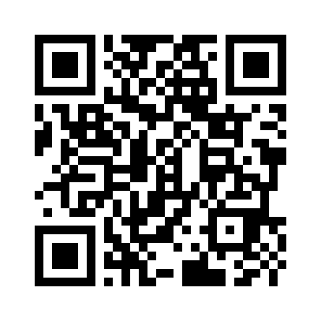
1:05
Scan it before parking
20 tools
Official links
What is actually free
Demo prompts
Contact Tony
huntermason.com/ai20
Save it now. Try one tonight.
Notes:
Scan this before we walk into the parking lot and forget nineteen of the twenty names. The page will have every official link, the free-versus-trial note, the demo prompts, and a way to contact me. My challenge is simple. Try one. Not twenty. One.

